Slide 1

Fuzzing Bug Depth Evaluation (How deep a bug is)
DEGAIL Dylan

Slide 2


University of Bristol
Notes:
Talk about:
→ The University of Bristol is a good university in the world.
→ Sanjay Rawat, my tutor, is a researcher and lecturer in the computer science department and a member of the Cyber Security Group of the University.

Slide 3

Goal of the internship
Understand the issues of Fuzzing
Know how to analyse a binary by the binary instrumentation
Notes:
Talk about:
→ First: What is it. How can we use the Fuzzing. What is the purpose of the Fuzzing. The potential improvements of the Fuzzing.
→ Second: Understand the step to do binary instrumentation.

Slide 4
What I needed to know

Slide 5
What is the Fuzzing
Program
Fuzzer
crashes
Inputs
Minimalist and simply representation
Notes:
Talk about:
→ What is the Fuzzing? How does it work?

Slide 6


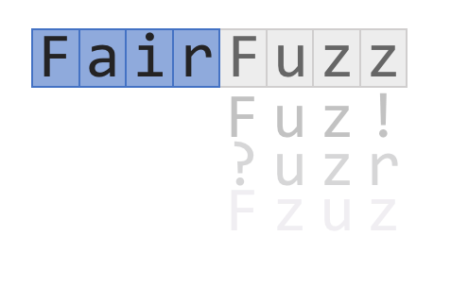
Research of software vulnerabilities
VUzzer
FairFuzz
AFL (american fuzzy lop)
Notes:
Talk about:
→ Different type of fuzzers and its characteristics.
→ AFL: a smart mutation-based fuzzer. AFL generates new inputs not randomly and based on a mutation of the new inputs.
→ VUzzer: evolutionary fuzzer. Generate specific inputs to reach a specific path of the program. Sanjay Rawat and Jean-Sebastien BONTEMPS on it.
→ FairFuzz: AFL + target rare branches to increase code coverage.
→ The goal is: the more we cover the code, the more we can find bugs and potentially, critical bugs.

Slide 7
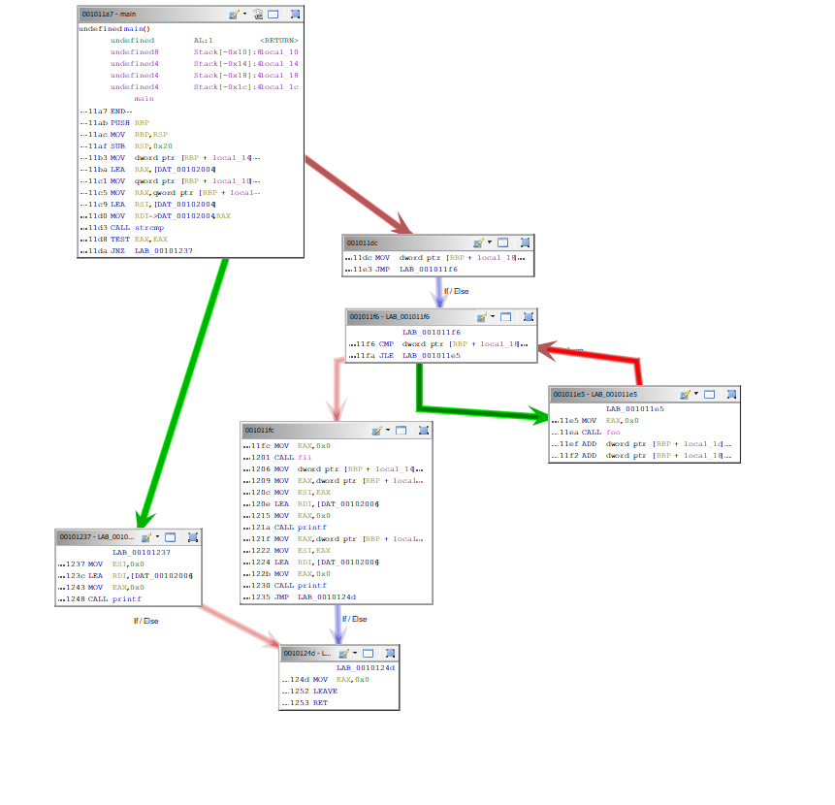
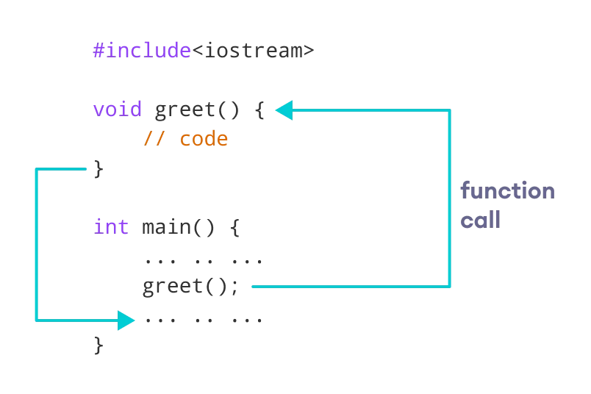
The “depth” of the bug
Branches
Functions
Notes:
Talk about:
→ 2 ways to evaluate the “depth” of the bug: branches and functions.

Slide 8

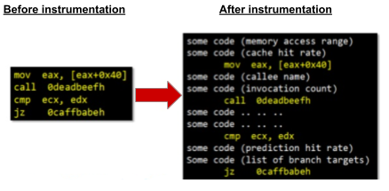
Dynamic binary instrumentation
Notes:
Talk about:
→ Intel Pin Tool: a dynamic binary instrumentation tool.
→ Analyse a binary by putting some code in the binary during the runtime.

Slide 9

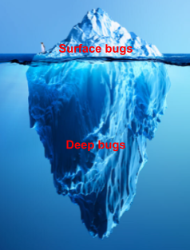
Problem in Fuzzing
When do you stop the fuzzing?
Notes:
Talk about:
→ The first and the principal problem of the Fuzzing is: when do you stop the Fuzzing?

Slide 10
What I have done

Slide 11
Conditional branch count
Increment by 1
Conditional branch?
MOV ...
CMP ...
Instrumentation code
JE ...
MOV ...
CMP ...
JE ...
Next instruction ...
MOV ...
JMP ...
Next instruction ...
Notes:
Talk about:
→ Explain this graphic easily (explain CMP, JE and JMP instructions).
→ First metric: number of conditional branches.

Slide 12
Conditional branch count
Increment by 1
MOV ...
CMP ...
Instrumentation code
JE ...
Taken branch?
Next instruction ...
MOV ...
CMP ...
JE ...
Next instruction ...
Notes:
Talk about:
→ explain this graphic easily (difference between taken or not branch)
→ Second metric: bug depth conditional branches (only taken branches!)

Slide 13
Call instruction count
Increment by 1
Call instruction?
MOV ...
XOR ...
Instrumentation code
CALL ...
MOV ...
XOR ...
CALL ...
Next instruction ...
MOV ...
XOR …
JMP ...
Next instruction ...
Notes:
Talk about:
→ Same that conditional branch count but here, we want to detect CALL instructions.

Slide 14
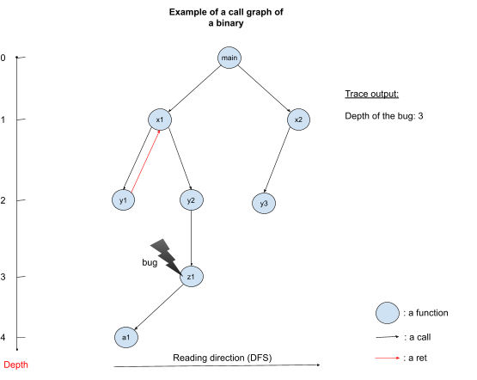
Call instruction count
Notes:
Talk about:
→ The third metric: bug depth call instructions.
→ Call graph illustration to understand easier the concept of “depth” bug.

Slide 15
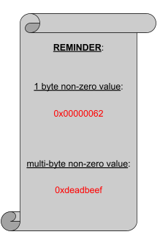
Complexity of conditional branches
Notes:
Talk about:
→ How I make a difference between a complex comparison and a non-complex comparison.
→ Reminder between 1 byte non-zero value and multi-byte non-zero value.

Slide 16
Complexity of conditional branches
complex = true
Complex?
MOV ...
Instrumentation code
CMP …, 0xdeadbeef
JE ...
MOV ...
CMP ..., 0xdeadbeef
JE ...
Next instruction ...
complex = false
MOV ...
Instrumentation code
CMP …, 0x00000062
JE ...
MOV ...
CMP …, 0x00000062
JE ...
Next instruction ...
Notes:
Talk about:
→ The last metric.
→ We instrument every time but true when there is a complex conditional branch and false when there is a non-complex conditional branch.

Slide 17
Evaluation part

Slide 18
Evaluation results
Evaluate library for the example: libxml2-v2.9.2
metrics
1-byte-read-heap-buffer-overflow
memory leak
Number of conditional branches
2 363 527
23 404 958
Bug depth conditional branches
(taken branches)
1 666 611
22 169 876
Complexity to reach a bug
58 871
219 079
Number of call instructions
64 184
345 799
Bug depth call instructions
6 695
14 518
Number of unique functions
516
569
Time to find
< 1 minute
< 1 hour
Seed
No
No
Notes:
Talk about:
→ Give a context of the evaluation results (libxml, 2 crashes, memory-leak and buffer-overflow).
→ Compare them.

Slide 19
Possible improvements
Static binary instrumentation
Get more data / have more metrics
Notes:
Talk about:
→ Static binary instrumentation (Dyninst): make the difference between dynamic binary instrumentation.
→ Have more binaries and bugs to increase results.

Slide 20
Why I have choose this internship

Slide 21









What I learned / used
Notes:
Talk about:
→ What did I learn?
→ Before all of that, I have learned the fuzzing domain. How it works, the employed techniques and
→ Analyse a software by instrument it with Intel Pin Tool
→ Developed in C++
→ Used some tools such as Docker, Google Cloud Platform for evaluation part ...

Slide 22
What I liked
Notes:
Talk about:
→ Work on an unknown subdomain of the IT security.
→ Learn some new technical skills such as binary analysis (binary instrumentation), the use of new tools …
→ Practice English and be more confident in English.

Slide 23
Acknowledgments
Notes:
Talk about:
→ Acknowledgments to all my teachers and especially, Mrs. Cartier and Mr. Bruno to give me this opportunity to have this internship. And of course, Sanjay Rawat, my tutor, for letting me discover this domain.
→ I have learned so much! It was so enriching.

Slide 24
Thank you

